Slide 1

Web Development
Devansh Rautela
Univ. Roll no. 2018314
Roll no. 20
Section – C
Course – B-Tech CSE

Slide 2



Web Development
Web development
Basic HTML
HTML Structures
Some terms in HTML

Slide 3



Web Development
Web development refers to the building, creating, and maintaining of websites. It includes aspects such as web design, web publishing, web programming, and database management. It is the creation of an application that works over the internet i.e. websites.

Slide 4

WEB DEVELOPMENT
Web development refers to the building, creating, and maintaining of websites. It includes aspects such as web design, web publishing, web programming, and database management. It is the creation of an application that works over the internet i.e. websites.
It is the work involved in developing a website for the internet (world wide web) or an intranet(a private network).
Web development can range from developing a simple page of plain text to complex web applications, electronic businesses , and network social network services.
A more comprehensive list of tasks to which web development commonly refers, may include web engineering, web design, web content development.

Slide 5
WHAT IS HTML?
The HyperText Markup Language or HTML is the standard markup language for documents designed to be displayed in a web browser. It can be assisted by technologies such as Cascading Style Sheets (CSS) and scripting languages such as Javascript.
Web browsers receive HTML documents from a web server or from local storage and render the documents into multimedia web pages. HTML describes the structure of a web page semantically and originally included cues for the appearance of the document.
HTML elements are the building blocks of HTML pages. With HTML constructs, images and other objects such as interactive forms may be embedded into the rendered page. HTML provides a means to create structured documents by denoting structural semantics for text such as headings, paragraphs, lists, links, quotes and other items

Slide 6
SOME TERMS IN HTML
HTML ELEMENTS
HTML ATTRIBUTES
HTML DOCUMENTS
HTML HEADING

Slide 7
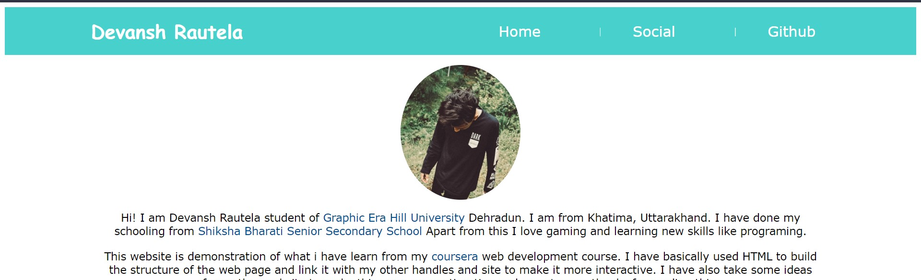
PROJECT
This is a trial project to show what I am learn till now from this web development course. I will further improve this project with the progress in my web development course.

Slide 8


Thank You
DEVANSH RAUTELA
SECTION – C
ROLL NO. – 20
UNIV. ROLLNO. – 2018314
STUDENT ID - 200111158

